Slide 1

Business Intelligence Presentation to Ninja Executives

Slide 2







Meet the Team
Eshal Farooq
Neha Jagasia
Heer Patel
Arya Rajesh
Shalmali Rao
Arya Suram
Role
Data
Analyst
Year
4th
Role
Pricing
Analyst
Year
4th
Role
Data
Scientist
Year
3rd
Role
Data
Analyst
Year
3rd
Role
Data
Scientist
Year
3rd
Role
Pricing
Analyst
Year
3rd

Slide 3
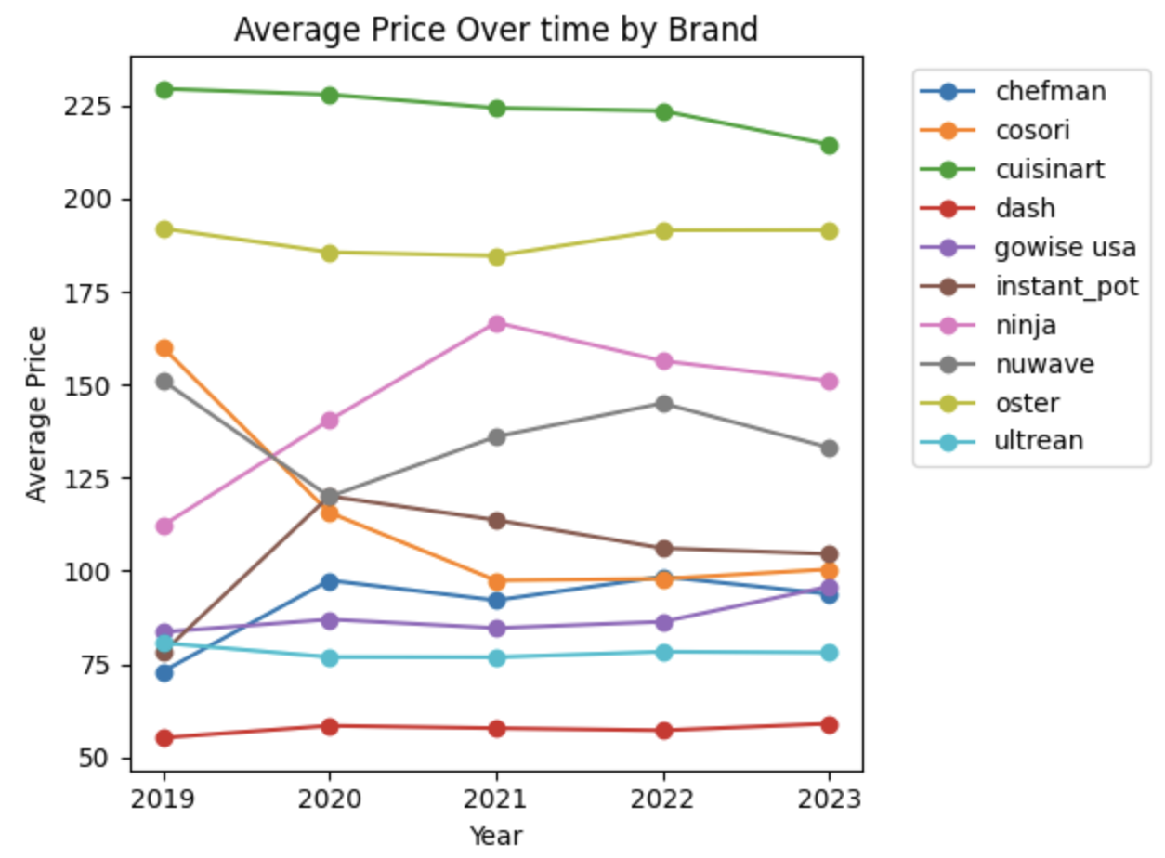
Air Fryer Market Overview
Popular Air Fryer Features
Compact design is the industry standard
Oven-style models are the secondary dominant format, particularly for premium brands.
Rare Air Fryer Features
Dual-basket models are nearly nonexistent currently
Rotisserie and Window features are highly niche, appearing primarily in a small subset of models from brands like Chefman and GoWise USA.
Competitive Analysis
Premium/Oven Specialists: Cuisinart and Oster focus on high-priced, oven-style units.
Value Specialists: Dash and Ultrean focus almost exclusively on low-cost, compact models.
Feature Leaders: Chefman and GoWise USA are more likely to incorporate "rare" features like rotisserie functions compared to the rest of the market
Industry Price Positioning
Most expensive brands: Cuisinart and Oster (consistently high)
Mid‑priced brands: Ninja, Instant Pot, NuWave
Budget brands: Dash, Chefman, Ultrean
Prices are fairly stable over time with no major shocks; brands compete in distinct price tiers, not targeting same consumers
Industry Background
Demand Model
Product Features
Pricing Analysis
Competitive Positioning

Slide 4
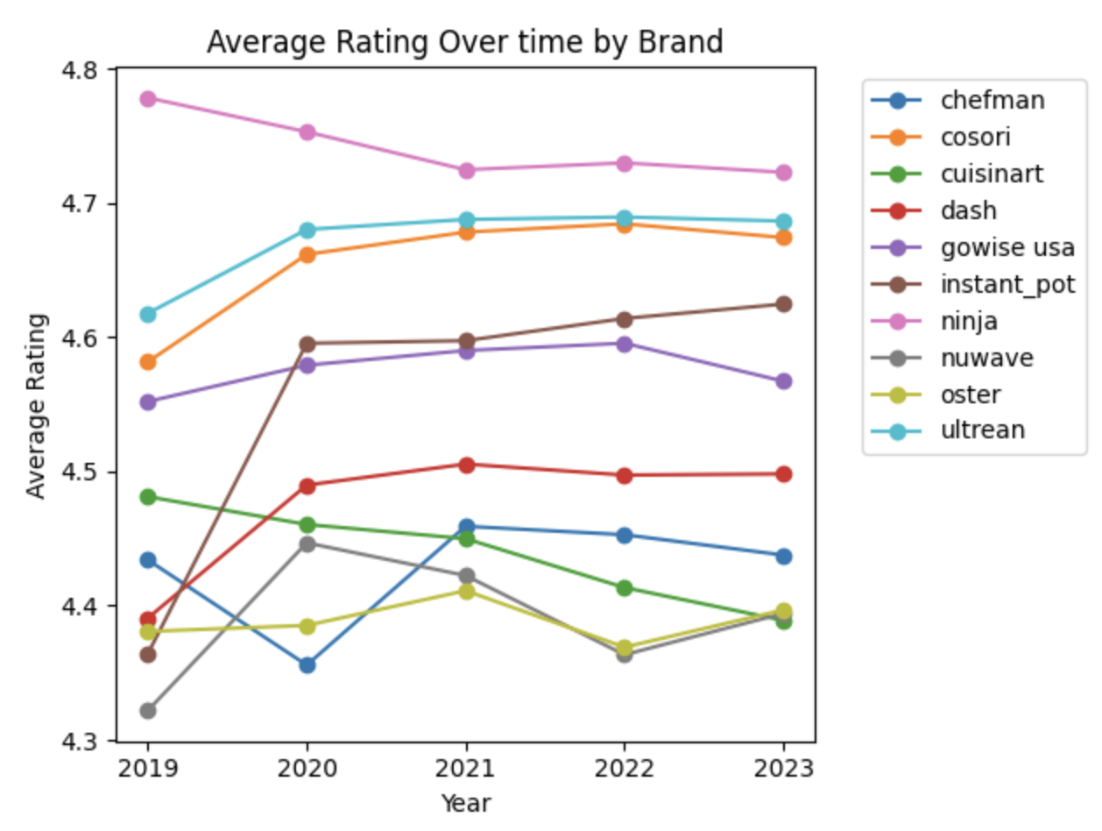
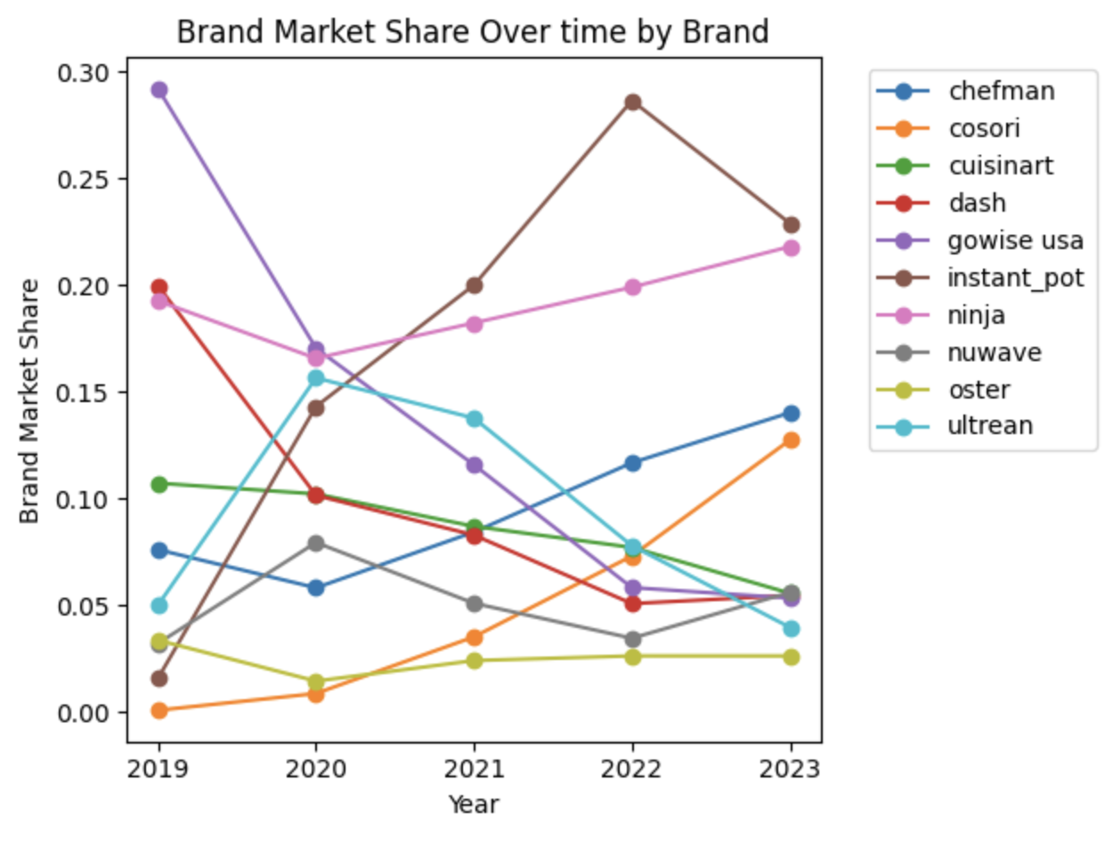
Air Fryer Market Overview (cont.)
Consumer Satisfaction Trends
Market Share Trends
Ratings are high across all brands, regardless if they are premium or budget (at roughly 4.3–4.8)
Ninja leads with the highest average rating across five years
Little variation over time, suggesting stable product quality except for Instant Pot, which has seen a large increase in ratings
No brand experiences a major decline in ratings
Suggests competition not driven by quality differences, but by price and features
Market leaders: GoWise USA (2019-2020), Ninja and Instant Pot (2020-2023)
Market structure is competitive but not stable; share leaders have shifted significantly
Instant Pot shows strong growth over time and is currently Ninja’s primary competitor
Laggers: Some brands (Dash, GoWise USA) lose share over time
Smaller brands remain niche but persistent (NuWave, Oster, Cuisinart)
Industry Background
Demand Model
Product Features
Pricing Analysis
Competitive Positioning

Slide 5
Demand Model & Price Coefficient Deep Dive
Demand Model
Model R²
Estimated consumer demand using a multinomial logit demand model
The log of brand share was modeled as a function of price, rating, product features, brand effects, and year effects
Model was estimated using linear regression on log market share
Allows for interpretation of how changes in price and product characteristics affect demand
Brand and year dummy variables included to capture differences across brands and time periods, isolating the effect of price while controlling for product quality and brand strength
~0.7635
The solid R² suggests that the model does a decent job capturing the main factors that influence brand demand. However, external macroeconomic factors may also play a part in estimating brand demand.
Negative State of Price Coefficient
Price Coefficient:
Economic Dynamics: Demand decreases as price increases
The higher a firm’s price is, the lower the market share that firm will have
The price coefficient being negative indicates that the demand curve is downward sloping and confirms the law of demand that for every dollar increase in price, log market share falls by 0.0377 log points, holding everything else constant
Thus, brands that charge more capture less of the market
-0.0377
One constant price coefficient shared by all brands and years
Industry Background
Demand Model
Product Features
Pricing Analysis
Competitive Positioning

Slide 6
Air Fryer Product Feature Analysis
Window Presence
Compact Size
Avoid Rotisserie and Dual Basket
Air fryer windows are the most impactful feature in the market.
Consumers value being able to monitor food without interrupting the cooking process, increasing convenience.
For Ninja, this implies that enhancing or emphasizing transparent cooking chambers should be a core product and marketing priority moving forward.
Compactness is the second strongest driver of demand, indicating that consumers likely prioritize saving counter space.
This reflects air fryers' status as secondary kitchen appliances, often used in smaller living spaces such as apartments or shared households.
Ninja should prioritize footprint reduction without sacrificing functionality. Marketing should position compact design as a key reason for adoption.
Rotisserie and dual basket features are associated with lower market shares.
Investment in these features is unlikely to drive demand and may detract from Ninja’s core positioning.
Ninja should prioritize allocating R&D for future models on features besides these two. Marketing should also avoid highlighting these as competitive differentiating factors for current models.
Industry Background
Demand Model
Product Features
Pricing Analysis
Competitive Positioning

Slide 7
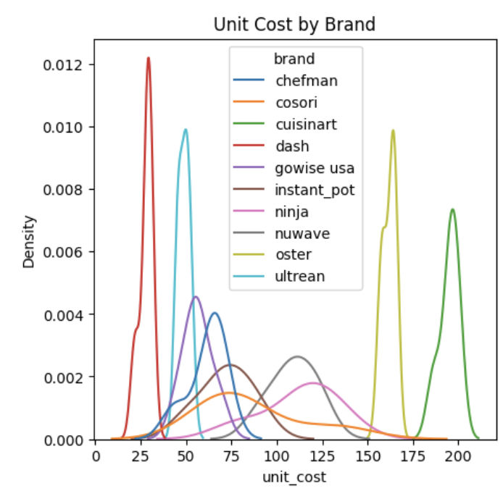
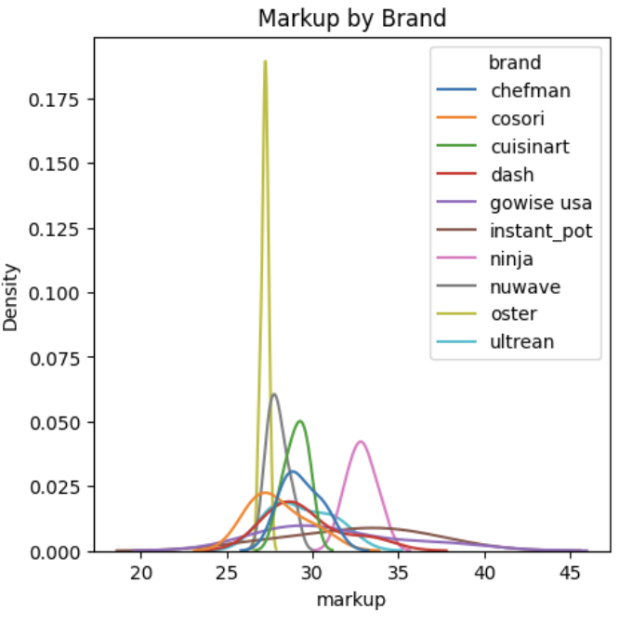
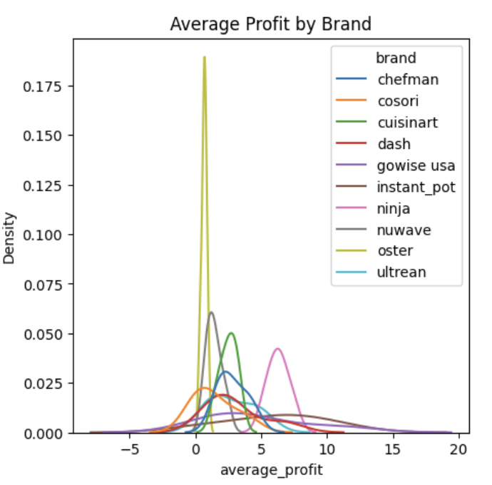
Pricing Analysis of Unit Costs, Markups, & Share-Weighted Profits
Takeaways from Pricing Analysis
Unit costs vary dramatically across brands, ranging from $27.94 for Dash to $194.90 for Cuisinart with Ninja at a mid-level cost of $112.49. Our analysis found that spending more in unit costs does not result in higher consumer satisfaction. So, Ninja should focus on product design and marketing rather than increasing production quality or production cost.
Markups are relatively uniform across brands, ranging from $27 to $33. This means premium brands charge more because of higher production costs, not because of greater pricing power. Given its strong positioning, Ninja has room to increase its $33 markup.
Ninja has the highest share-weighted profit of 6.31 with its main competitor Instant Pot trailing behind at 6.01 and all other brands meaningfully below this. Thus, Ninja has dominant profitability led by its dominant market share.
Ninja should focus on protecting and growing market share and increasing its markup going forward to maintain its position.
Industry Background
Demand Model
Product Features
Pricing Analysis
Competitive Positioning

Slide 8
Market Positioning Key Takeaways
Competitive Landscape
The average rating across brands is consistent and stable (ranging between 4.3-4.8), but brand shares fluctuate drastically with Instant Pot and Ninja leading and Chefman and Cosori also trending upwards
Most brands have average profits ranging from ~0 to ~5, except for Ninja, Instant Pot, and GoWise USA leading with average profits between ~5 and ~10
Ninja and Instant Pot have significantly higher share-weighted average profits at 6.31 and 6.01, respectively
Overall, Ninja and Instant Pot are the market leaders for their mid-priced air fryers and large market shares.
Price vs. Rating
Bubble size = market share
4.80
Ninja
4.75
4.70
Ultrean
Cosori
4.65
4.60
GoWise USA
Ninja’s Current Positioning
Average Rating
4.55
Ninja has the highest average market share (19%), best average consumer ratings (4.74), and highest share-weighted profit (6.31)
On these dimensions, Ninja clearly beats out competition and positions itself as the market leader
Ninja also holds the best brand equity where its fixed effects are 5.84 points above the baseline, indicating consumers choose Ninja even when controlling for price, ratings, and features
Next Steps: Ninja has room to raise prices as the industry premium leader. Its current markup of $33 is barely higher than Dash’s markup of $30 despite Ninja’s brand strength and superior ratings. Ninja should also focus on growing its market share in order to maximize profitability.
Competition: Ninja should be wary of Instant Pot since it is the only brand with a share-weighted profit close to Ninja’s of 6.01 and has strong brand recognition from their pressure cooker halo. If the brand invests more aggressively in their air fryer segment, it could threaten Ninja’s dominance.
4.50
Instant Pot
4.45
Dash
Cuisinart
4.40
Chefman
NuWave
Oster
4.35
$60
$80
$110
$120
$140
$160
$180
$200
$220
Average Price
Industry Background
Demand Model
Product Features
Pricing Analysis
Competitive Positioning

